Slide 1


Smart Resource Booking & Management System
Efficient, Transparent, and Reward-Driven Resource Management
Department of Computer Science and Engineering
Presented by: Vatsal Sharma ; 2427030235
Supervised by: Ms. Harshika Mathur
Section: G

Slide 2


The Resource Management Challenge Today
Conflict & Delays
Manual Overhead
Under-Optimization
70% of organizations report resource conflicts and underutilization causing project delays and cost overruns.
Manual booking leads to double bookings, wasted administrative time, and frustrated teams and users.
Human and physical resources are often under-optimized, significantly impacting profitability and employee satisfaction.

Slide 3



What is Smart Resource Booking & Management?
It is a holistic digital approach to resource utilization, ensuring resources are always allocated efficiently and transparently.
Automated Scheduling
Real-Time Availability
Maximum Productivity
Streamlined allocation of critical assets: rooms, equipment, personnel, vehicles, and more.
Intelligent matching algorithms provide instant booking options and conflict resolution.
Enables the "right resource, right time, right place" for peak productivity and cost control.

Slide 4
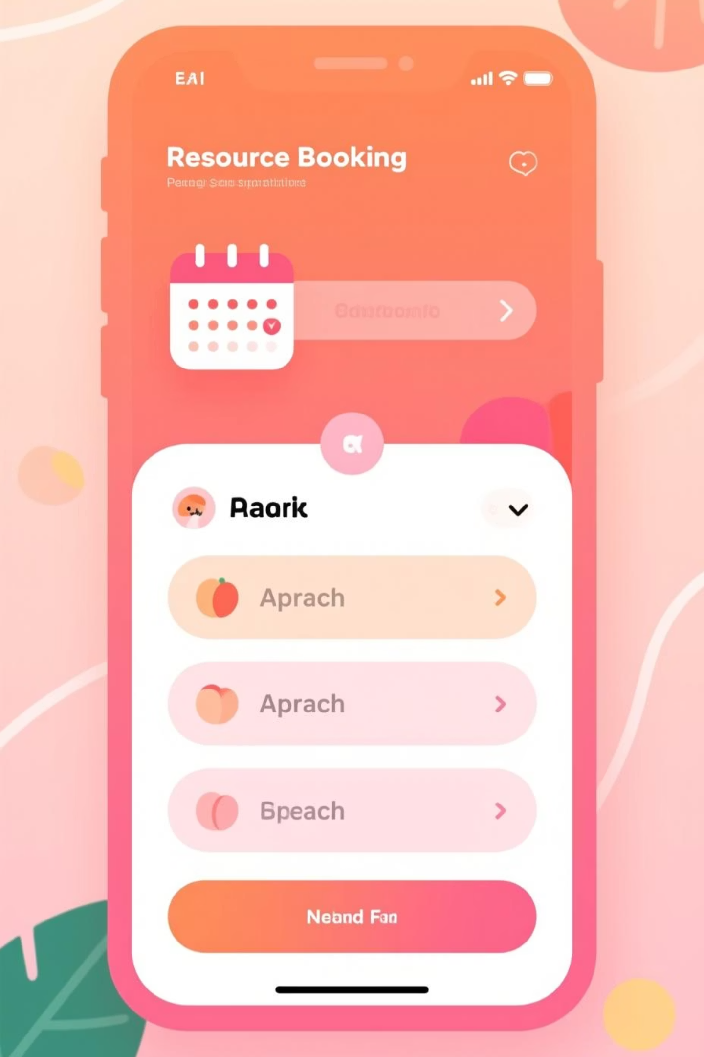


Core Capabilities of Smart Booking Systems
Instant Resource Search & Booking
Advanced filters for location, capacity, equipment, and accessibility (e.g., Optime Booker functionality).
Automated Approval Workflows
Configurable booking rules and verification steps to prevent misuse and ensure policy compliance.
Calendar & Signage Integration
Seamless synchronization with Google, Outlook, and digital signage for live, visible status updates.
Utilization Data Analytics
Dashboards providing deep insights into resource usage for strategic planning and optimization.

Slide 5
Core Capabilities of Smart Booking Systems
Instant Resource Search & Booking
Advanced filters for location, capacity, equipment, and accessibility (e.g., Optime Booker functionality).
Automated Approval Workflows
Configurable booking rules and verification steps to prevent misuse and ensure policy compliance.
Calendar & Signage Integration
Seamless synchronization with Google, Outlook, and digital signage for live, visible status updates.
Utilization Data Analytics
Dashboards providing deep insights into resource usage for strategic planning and optimization.

Slide 6

Benefits That Transform Your Organization
50%
30%
95%
Reduction in Administrative Overhead
Increase in Resource Usage Rates
Improvement in User Satisfaction
Save Time: Eliminate manual coordination and free up staff for higher-value tasks.
Enhance Collaboration: Seamless booking fosters better teamwork and ensures timely meeting starts.
Maximize Utilization: Increase asset usage rates, reducing costs associated with idle equipment and space.
Cut Costs: Avoid overbooking penalties and optimize space planning to reduce real estate expenses.

Slide 7



Real-World Success Stories
The smart resource model has proven successful across diverse, resource-intensive environments:
Higher Education
Healthcare Facilities
Global Corporations
University campuses improved lecture hall and equipment utilization by 35%.
Coordinating clinical spaces and equipment, reducing scheduling conflicts by 40%.
Managing hot desks, meeting rooms, and IT assets centrally to boost employee productivity.

Slide 8

Seamless Implementation & Adoption Strategy
Our structured approach ensures a smooth transition and rapid value realization for your organization.
01
1. Needs Assessment
Tailoring the system to your unique mix of resources, existing policies, and organizational structure.
02
2. Infrastructure Integration
Connecting seamlessly with existing IT infrastructure, LDAP, and calendar systems (Outlook, Google).
03
3. User-Friendly Deployment
Implementing intuitive interfaces across mobile apps, web portals, and dedicated room touch panels.
04
4. Training & Support
Comprehensive training and robust ongoing support ensure high user adoption and minimal downtime.

Slide 9
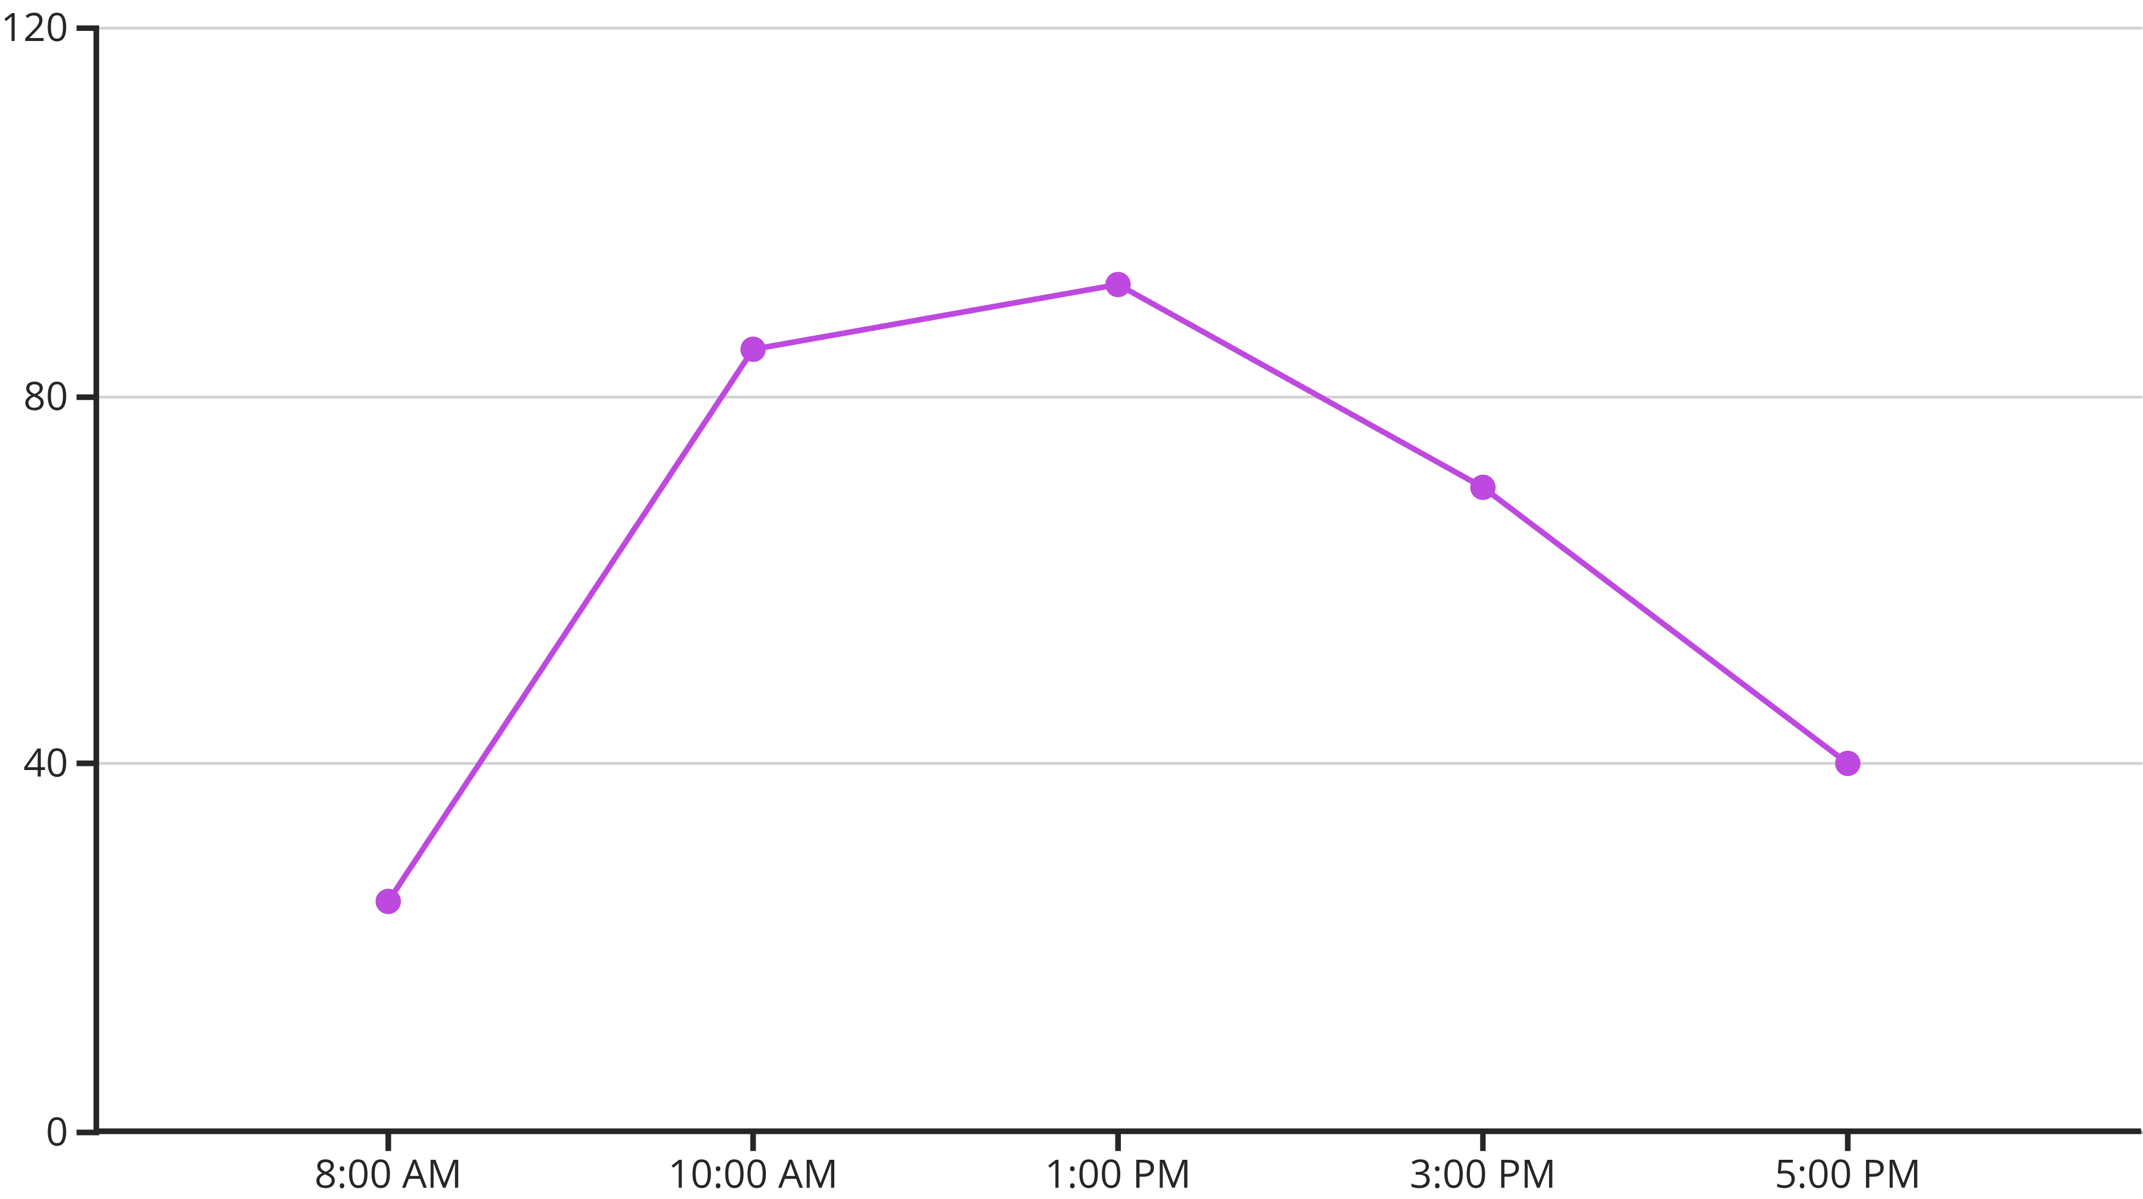
Advanced Analytics for Continuous Optimization
Track & Identify Trends
Data-Driven Forecasting
Enterprise Integration
Visual, easy-to-read reports track booking patterns and quickly identify underused or bottlenecked resources.
Utilize historical data and current trends to forecast demand and strategically plan for future capacity needs.
API access allows deep integration with ERP, HR, and facilities management systems for unified data.

Slide 10




The Future of Resource Management is Smart & Connected
Our platform is designed to evolve, incorporating next-generation technologies for truly autonomous management.
AI-Powered Allocation
IoT Integration
Machine learning algorithms provide optimal recommendations for resource matching and demand forecasting.
Support for sensors and IoT devices for automated check-ins, auto-unlock features, and environment control.
Enhanced User Experience
Future interaction through voice commands, generative AI chatbots, and predictive notifications.

Slide 11



Unlock Your Organization’s Full Potential Today
Boost Efficiency
Seamless, conflict-free operations that support rapid organizational growth.
Reduce Operational Costs
Optimal utilization of every asset, translating directly into tangible cost savings.
Empower Your Teams
Provide the resources employees need, when they need them, fostering productivity and satisfaction.
Thank You! Any Questions?

